Slide 2
Nuix Developer Community Update & What's new for Developers in 7.6
Presented by Jason Wells

Slide 3
What’s New for the Nuix Developer Community?

Slide 4
Nuix Integrated Solutions Team
Champions of the API
Daniel Berry
Chip Carlson
Jason Pope
Jason Wells

Slide 5

Visit us on GitHub
github.com/nuix
Find the latest versions of popular Nuix scripts
Advanced examples created by Nuix
Follow development as it occurs
Fork your own copy for customizations
Contribute fixes and enhancements
Some little before seen JAR source code
Lets take a look

Slide 6
What’s New in the 7.6 APIs?

Slide 7
Settings Profiles

Slide 8
Settings Profiles
Save and load groups of settings for:
Processing
OCR
Metadata import and export
Productions
Imaging

Slide 9
Settings Profiles
Provides a mechanism for consistent settings across operations, regardless of whether they are performed in the GUI or in the API.

Slide 10
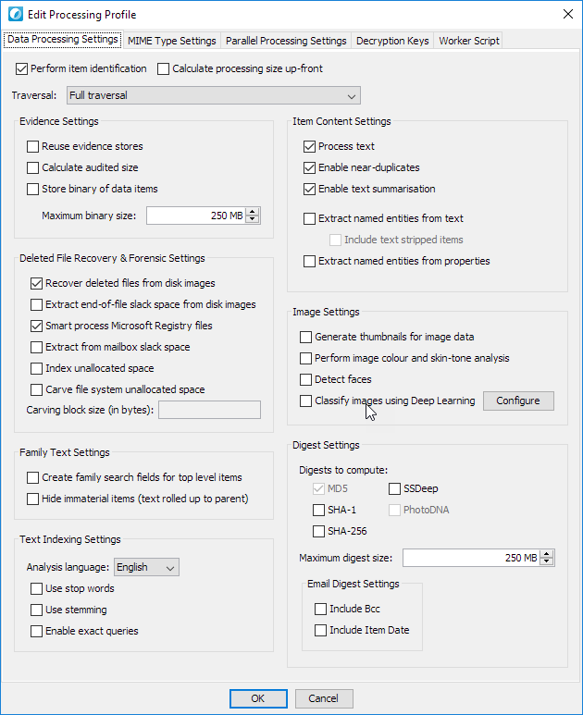
Settings Profiles
Build profiles GUI
Use them in your code

Slide 11
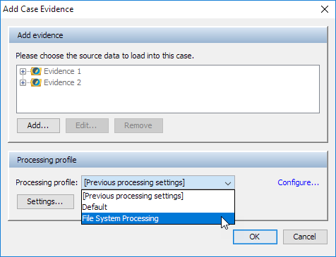
Settings Profiles
Build profiles in code
Use them from the GUI

Slide 12
processing_settings = {
"addBccToEmailDigests" => false,
"addCommunicationDateToEmailDigests" => false,
"analysisLanguage" => "en",
"calculateAuditedSize" => true,
"calculateSSDeepFuzzyHash" => false,
"carveFileSystemUnallocatedSpace" => false,
"createThumbnails" => false,
"detectFaces" => false,
"digests" => [
"MD5"
],
# Etc....
}
processor.setProcessingSettings(processing_settings)
parallel_processing_settings = {
"workerCount" => 4,
"workerMemory" => 1024,
"workerTemp" => "C:\\WorkerTemp",
}
processor.setParallelProcessingSettings(parallel_processing_settings)
processor.setMimeTypeProcessingSettings("application/dll",{"enabled"=>false})
processor.setMimeTypeProcessingSettings("application/pdf",{"processEmbedded"=>false})

Slide 13
processor.setProcessingProfile("File System Ingestion")
Questions?

Slide 14
Settings Profiles
The general pattern
Each profile type has an associated “builder”
Each profile type has an associate “store”
Builder has a fluent interface

Slide 15
Settings Profiles
The general pattern – Processing Profile
ProcessingProfileStore
ProcessingProfile
ProcessingProfileBuilder

Slide 16
builder = $utilities.getProcessingProfileBuilder()
builder.withName("Special Processing Profile")
builder.withMimeTypeSettings({
"workerCount" => 4,
"workerMemory" => 1024,
"workerTemp" => "C:\\WorkerTemp",
})
builder.withProcessingSettings({
"addBccToEmailDigests" => false,
"addCommunicationDateToEmailDigests" => false,
"analysisLanguage" => "en",
"calculateAuditedSize" => true,
"calculateSSDeepFuzzyHash" => false,
"carveFileSystemUnallocatedSpace" => false,
"createThumbnails" => false,
"detectFaces" => false,
"digests" => [
"MD5"
],
# Etc....
})
profile = builder.build()

Slide 17
builder = $utilities.getProcessingProfileBuilder()
builder
.withName("Special Processing Profile")
.withMimeTypeSettings({
"workerCount" => 4,
"workerMemory" => 1024,
"workerTemp" => "C:\\WorkerTemp",
})
.withProcessingSettings({
"addBccToEmailDigests" => false,
"addCommunicationDateToEmailDigests" => false,
"analysisLanguage" => "en",
"calculateAuditedSize" => true,
"calculateSSDeepFuzzyHash" => false,
"carveFileSystemUnallocatedSpace" => false,
"createThumbnails" => false,
"detectFaces" => false,
"digests" => [
"MD5"
],
# Etc....
})
profile = builder.build()
Questions?

Slide 18
Metadata Import Processor

Slide 19
Metadata Import Processor
Allows you to:
Import tags
Import custom metadata

Slide 20
Metadata Import Processor
Supports:
CSV – Comma Separated Values
TSV – Tab Separated Values
Concordance DAT
XML
JSON
Custom Delimited Format
Database

Slide 21
Metadata Import Processor
Input Requirements
A way for Nuix to identify the item:
GUID
Item Number
MD5
Production Set ID
Fields containing the data to be recorded

Slide 22
Metadata Import Processor
MetadataImportProcessor to import
MetadataImportProfile to configure
MetadataImportProfileBuilder to build profiles

Slide 23
Slipsheet Template

Slide 24
Slip Sheet Template
Provide fine grained control over how slip sheet images are generated for items.

Slide 25
Slip Sheet Template
SlipsheetTemplate contains configuration
SlipSheetTemplateBuilder to construct
Used by ImagingProfile which in turn can be provided to operations performing imaging

Slide 26
slipsheet_builder = $utilities.getSlipSheetTemplateBuilder
slipsheet_builder
.withName("Custom Template")
.withTitleCustomFontFamily("Arial")
.withTitleCustomFontSize(16)
.withBodyCustomFontFamily("Courier")
.withBodyCustomFontSize(12)
.withBodyUseCustomFont(true)
# ... etc
.withBodyCustomText("See Native")
.withBodyUseCustomText(true)
slipsheet_profile = slipsheet_builder.build
Questions?

Slide 27
Other Additions to the API

Slide 28
EvidenceContainer
addRealtimeLocation(Map options)
Add real-time sources to an evidence container:
Nuix Adaptive Security
Kafka
Twitter
File System Directory Watcher

Slide 29
EvidenceContainer.addRealTimeLocation
processor = $current_case.createProcessor
evidence_name = "AutoIngested"
evidence_container = processor.newEvidenceContainer(evidence_name)
realtime_location_setting = {
"type" => "watchedDirectory",
"directoryPath" => "C:\\Temp\\AutoIngested",
}
evidence_container.addRealtimeLocation(realtime_location_setting)
evidence_container.save
Questions?

Slide 30
Processor
addBulkEvidence(String csvFilePath)
Add a series of evidence containers based on the contents of a CSV file.
Can add data to existing evidence containers or implicitly create new evidence containers.

Slide 31
Processor
addBulkEvidence(String csvFilePath)
The CSV contains a series of columns depending the data to be added.
Supported source data types:
File / Directory
SharePoint
Exchange
S3

Slide 32
Processor.addBulkEvidence
evidenceName | evidenceType | data
Email | file | Z:\SourceData\S_Bob\Email\Emails.pst
File Share | folder | Z:\SourceData\S_Bob\FileShareCollection\
processor = $current_case.createProcessor
processor.addBulkEvidence('Z:\SourceData\S_Bob\evidence.csv')
Questions?

Slide 33
Processor
newEvidenceRepository(String path, Map params)
While this method is not new, it does now accept some new parameters:
timeZone – Default time zone
Charset – Default character set
Language – Default locale language
countryCode – Default locale

Slide 34
Processor.newEvidenceRepository
processor = $current_case.createProcessor
repository_path = 'C:\Data\Repositories'
evidence_repository_settings = {
"custodianLevel" => 0,
"evidenceContainerNaming" => "content",
"evidenceContainerNamingPrefx" => nil,
"timeZone" => "America/Los_Angeles", # New in 7.6
"charset" => "UTF8", # New in 7.6
"language" => "en-US", # New in 7.6
"countryCode" => "en-US", # New in 7.6
}
processor.newEvidenceRespository(repository_path,evidence_repository_settings)
Questions?

Slide 35
WorkerItem
setItemName(String name)
Allows you to define, from a WSS, the name assigned to an item.
Previously this would be whatever value Nuix assigned (file name, email subject, etc).

Slide 36
WorkerItem.setItemName
def nuix_worker_item_callback(worker_item)
source_item = worker_item.getSourceItem
kind = source_item.getKind.getName
original_name = source_item.getName
updated_name = "#{kind} - #{original_name}"
# In 7.6 you can specify the item name
worker_item.setItemName(updated_name)
end
Questions?

Slide 37
SourceItem
getDigests()
This doesn’t add anything new from WSS perspective because we already had WorkerItem.getDigests
This adds the ability to determine digests when “scanning” data via SourceItemFactory

Slide 38
SourceItem.getDigests
# Create a SourceItemFactory instance
$utilities.createSourceItemFactory(settings) do |source_item_factory|
# Have the SourceItemFactory instance begin traversal with our input file
source_item_factory.openFile(input_file) do |root_source_item|
# Use helper method to simplify recursive traversal
traverse(root_source_item) do |source_item|
# In 7.6 you can get digests for this source item
digests = source_item.getDigests
md5 = digests.getMd5
end
end
end
Questions?

Slide 39
SourceItem
getShannonEntropy()
Allows you to get the Shannon Entropy value for a SourceItem, something that was not available before on on SourceItem or WorkerItem.

Slide 40
SourceItem.getShannonEntropy
# Create a SourceItemFactory instance
$utilities.createSourceItemFactory(settings) do |source_item_factory|
# Have the SourceItemFactory instance begin traversal with our input file
source_item_factory.openFile(input_file) do |root_source_item|
# Use helper method to simplify recursive traversal
traverse(root_source_item) do |source_item|
# In 7.6 you can also get the Shannon Entropy value of an item
shannon_entropy = source_item.getShannonEntropy
end
end
end
Questions?

Slide 41
ProductionSet
setDescription(String description)
Allows you to change a production set’s description after it is created.
Before you could only set this at the time of production set creation (or trickery).

Slide 42
ProductionSet.setDescription
production_set = $current_case.findProductionSetByName("Prod003")
production_set.setDescription("Third production produced")
Questions?

Slide 43
BatchExporter
setSkipNativesSlipsheetedItems(boolean value)
Sets whether items with a slip sheet should have natives exported for it.

Slide 44
BatchExporter.setSkipNativesSlipsheetedItems
export_directory = "C:\\NuixExport"
exporter = $utilities.createBatchExporter(export_directory)
loadfile_settings = {
"metadataProfile" => "Email",
"encoding" => "UTF-8",
}
exporter.addLoadFile("concordance",loadfile_settings)
native_settings = {
"naming" => "document_id",
"path" => "natives",
"mailFormat"=> "msg",
"includeAttachments" => true,
}
exporter.addProduct("native",native_settings)
exporter.setSkipNativesSlipsheetedItems(true)
exporter.exportItems(items)
Questions?

Slide 45
Case
findCustodianByName(String name)
Returns a Custodian object rather than just a string containing the custodian’s name.
Custodian object has an associated description.

Slide 46
Case.findCustodianByName
custodian_object = $current_case.findCustodianByName("Bob")
puts "Name: #{custodian_object.getName}"
puts "Description: #{custodian_object.getDescription}"
custodian_object.setName("John")
custodian_object.setDescription("He is not Bob")
Questions?

Slide 47
Item
getDetectedFaces()
Gets the face detection data for an item, if it has any.
Face detection data is returned as a collection of DetectedFace objects.

Slide 48
Item.getDetectedFaces
items_with_faces = $current_case.search("faces:[1 TO *]")
items_with_faces.each do |item|
puts "==== Item Name: #{item.getLocalisedName} ===="
detected_faces = item.getDetectedFaces
detected_faces.each_with_index do |detected_face,face_index|
puts "== Face Number #{face_index+1} =="
puts "Confidence: #{detected_face.getConfidence}"
puts "Width: #{detected_face.getWidth}"
puts "Height: #{detected_face.getHeight}"
puts "X,Y: #{detected_face.getX}, #{detected_face.getY}"
puts "Is Hardware Detected?: #{detected_face.isHardwareDetected}"
end
end
Questions?

Slide 49
Visit us at
github.com/nuix

